Slide 1


고급AI융합프로젝트
Rehearsal
- 이상행동 탐지 모델 개발 -
Development of abnormal behavior model.
석사과정 조혜원 2025.12.02
My name is Haewon Jo, a master's student at the Computer Vision Lab, Chonnam National University.

Slide 2
고급AI융합프로젝트
Rehearsal
- 이상행동 탐지 모델 개발 -
Development of abnormal behavior model.
석사과정 조혜원 2025.11.26
Today, I will be presenting on the "Development of an Abnormal Behavior Model," which was conducted as part of the Advanced AI Convergence Project.

Slide 3

Project Overview
Project Title
이상행동 탐지 모델 개발 ; Development of abnormal behavior model.
Goal
Real-time video analysis for detecting theft & vandalism with automatic alerts.
Since abnormal behavior is too board, we narrow the scope to theft detection in indoor retail stores.
실시간 영상을 분석하여, 절도나 기물파손 같은 사건이 발생하면 자동으로 탐지하고 경보를 보내는 기능 구축
이상행동은 너무 광범위하기 때문에, 실내 매장에서 절도 감지로 범위를 축소
Using Data
PoseLift ;
Exploring Pose-Based Anomaly Detection for Retail Security : A Real-Wrold Shoplifting Dataset and Benchmark (WACV 2025)
Company
주식회사 빅태블릿
Let me start with the project overview. Our goal is to build a system that analyzes video in real-time to automatically detect incidents like theft or vandalism and send alerts.

Slide 4
Project Overview
Project Title
이상행동 탐지 모델 개발 ; Development of abnormal behavior model.
Goal
Real-time video analysis for detecting theft & vandalism with automatic alerts.
Since abnormal behavior is too board, we narrow the scope to theft detection in indoor retail stores.
실시간 영상을 분석하여, 절도나 기물파손 같은 사건이 발생하면 자동으로 탐지하고 경보를 보내는 기능 구축
이상행동은 너무 광범위하기 때문에, 실내 매장에서 절도 감지로 범위를 축소
Using Data
PoseLift ;
Exploring Pose-Based Anomaly Detection for Retail Security : A Real-Wrold Shoplifting Dataset and Benchmark (WACV 2025)
Company
주식회사 빅태블릿
Since the concept of "abnormal behavior" is quite broad, we narrowed our scope specifically to "theft detection."

Slide 5
Project Overview
Project Title
이상행동 탐지 모델 개발 ; Development of abnormal behavior model.
Goal
Real-time video analysis for detecting theft & vandalism with automatic alerts.
Since abnormal behavior is too board, we narrow the scope to theft detection in indoor retail stores.
실시간 영상을 분석하여, 절도나 기물파손 같은 사건이 발생하면 자동으로 탐지하고 경보를 보내는 기능 구축
이상행동은 너무 광범위하기 때문에, 실내 매장에서 절도 감지로 범위를 축소
Using Data
PoseLift ;
Exploring Pose-Based Anomaly Detection for Retail Security : A Real-Wrold Shoplifting Dataset and Benchmark (WACV 2025)
Company
주식회사 빅태블릿
We utilized the "PoseLift" dataset, recently presented at WACV 2025, and conducted this project in collaboration with Big Tablet Co., Ltd.

Slide 6
Project Overview
Background
The adoption of unmanned buildings has recently increased to reduce labor costs and facilitate convenient 24-hour operations.
While these buildings primarily rely on CCTV for security, traditional systems focus on post-incident analysis, limiting their effectiveness in real-time response and prevention.
To address these issues, we have developed a service utilizing an intelligent CCTV system to detect abnormal behaviors (such as theft) within the building and notify users immediately.
Ko.
최근 인건비 절감과 24시간 운영의 편리성을 위해 무인 건물의 도입이 증가
이러한 건물들은 주로 CCTV를 통해 보안을 유지하지만, 전통적인 CCTV 시스템은 사후 처리에 중점을 두고 있어 실시간 대응과 예방에는 한계가 존재
이러한 문제들을 해결하고자, 지능형 CCTV 시스템을 도입하여 CCTV가 필요한 건물 내에서 발생할 수 있는 이상행동(절도)을 감지하고 사용자에게 알리는 서비스를 개발
Here is the background of our research. Recently, the adoption of unmanned buildings has been increasing to reduce labor costs and enable convenient 24-hour operations.

Slide 7

Project Overview
Background
The adoption of unmanned buildings has recently increased to reduce labor costs and facilitate convenient 24-hour operations.
While these buildings primarily rely on CCTV for security, traditional systems focus on post-incident analysis, limiting their effectiveness in real-time response and prevention.
To address these issues, we have developed a service utilizing an intelligent CCTV system to detect abnormal behaviors (such as theft) within the building and notify users immediately.
Ko.
최근 인건비 절감과 24시간 운영의 편리성을 위해 무인 건물의 도입이 증가
이러한 건물들은 주로 CCTV를 통해 보안을 유지하지만, 전통적인 CCTV 시스템은 사후 처리에 중점을 두고 있어 실시간 대응과 예방에는 한계가 존재
이러한 문제들을 해결하고자, 지능형 CCTV 시스템을 도입하여 CCTV가 필요한 건물 내에서 발생할 수 있는 이상행동(절도)을 감지하고 사용자에게 알리는 서비스를 개발
While these facilities rely primarily on CCTV for security, traditional systems focus on post-incident analysis, which limits their effectiveness in real-time response and prevention.

Slide 8
Project Overview
Background
The adoption of unmanned buildings has recently increased to reduce labor costs and facilitate convenient 24-hour operations.
While these buildings primarily rely on CCTV for security, traditional systems focus on post-incident analysis, limiting their effectiveness in real-time response and prevention.
To address these issues, we have developed a service utilizing an intelligent CCTV system to detect abnormal behaviors (such as theft) within the building and notify users immediately.
Ko.
최근 인건비 절감과 24시간 운영의 편리성을 위해 무인 건물의 도입이 증가
이러한 건물들은 주로 CCTV를 통해 보안을 유지하지만, 전통적인 CCTV 시스템은 사후 처리에 중점을 두고 있어 실시간 대응과 예방에는 한계가 존재
이러한 문제들을 해결하고자, 지능형 CCTV 시스템을 도입하여 CCTV가 필요한 건물 내에서 발생할 수 있는 이상행동(절도)을 감지하고 사용자에게 알리는 서비스를 개발
To address this, we developed a service using an intelligent CCTV system that detects abnormal behaviors, such as theft, in real-time and immediately notifies the user.

Slide 9

Project Development
Overall Detection Process Overview
Video Input : CCTV or Video
Pose Extraction : Estimate and track human pose from video
STG-NF Mapping : Transform pose data using the ‘normal’ trained model
Probability Calculation : Calculate likelihood to detect anomalies
INPUT
→
STAGE 1
→
STAGE 2
→
STAGE 3
→
OUTPUT
Video
YOLOv8-Pose
Preprocessing
STG-NF
Alert
Normal Action
High Likelihood
Abnormal Action
Low Likelihood
Pose Extraction
Preprocessing
STG-NF Model
Extract 17 COCO keypoints per person
17→18 keypoints + 24-frame window
Compute NLL as anomaly score
Next is the overall detection process.
The system takes CCTV or video footage as input, then estimates and tracks human poses.

Slide 10
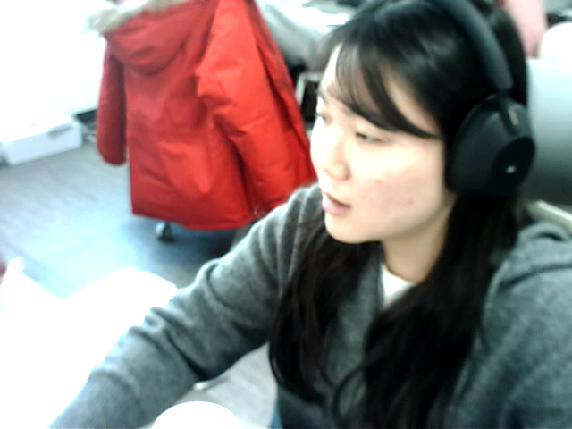
Project Development
Overall Detection Process Overview
Video Input : CCTV or Video
Pose Extraction : Estimate and track human pose from video
STG-NF Mapping : Transform pose data using the ‘normal’ trained model
Probability Calculation : Calculate likelihood to detect anomalies
INPUT
→
STAGE 1
→
STAGE 2
→
STAGE 3
→
OUTPUT
Video
YOLOv8-Pose
Preprocessing
STG-NF
Alert
Normal Action
High Likelihood
Abnormal Action
Low Likelihood
Pose Extraction
Preprocessing
STG-NF Model
Extract 17 COCO keypoints per person
17→18 keypoints + 24-frame window
Compute NLL as anomaly score
This data is processed by the STG-NF model, which is trained only on "normal" behaviors.
If the action is normal, the model predicts it well, resulting in a high probability score.

Slide 11
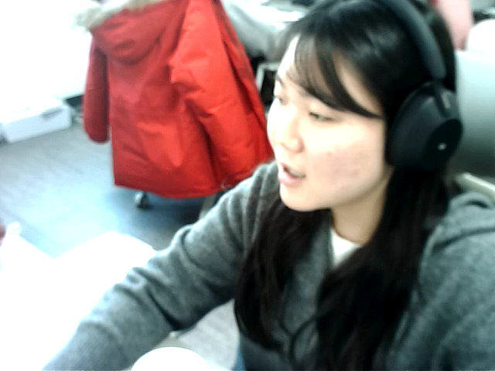
Project Development
Overall Detection Process Overview
Video Input : CCTV or Video
Pose Extraction : Estimate and track human pose from video
STG-NF Mapping : Transform pose data using the ‘normal’ trained model
Probability Calculation : Calculate likelihood to detect anomalies
INPUT
→
STAGE 1
→
STAGE 2
→
STAGE 3
→
OUTPUT
Video
YOLOv8-Pose
Preprocessing
STG-NF
Alert
Normal Action
High Likelihood
Abnormal Action
Low Likelihood
Pose Extraction
Preprocessing
STG-NF Model
Extract 17 COCO keypoints per person
17→18 keypoints + 24-frame window
Compute NLL as anomaly score
Conversely, abnormal actions like theft result in a low probability, allowing us to detect anomalies.

Slide 12

Project Development
Overall Detection Process Overview
Video Input : CCTV or Video
Pose Extraction : Estimate and track human pose from video
STG-NF Mapping : Transform pose data using the ‘normal’ trained model
Probability Calculation : Calculate likelihood to detect anomalies
INPUT
→
STAGE 1
→
STAGE 2
→
STAGE 3
→
OUTPUT
Video
YOLOv8-Pose
Preprocessing
STG-NF
Alert
Normal Action
High Likelihood
Abnormal Action
Low Likelihood
Pose Extraction
Preprocessing
STG-NF Model
Extract 17 COCO keypoints per person
17→18 keypoints + 24-frame window
Compute NLL as anomaly score
Stage 1 is pose extraction using YOLOv8-Pose. For each video frame, we detect people and extract 17 COCO keypoints.

Slide 13

Project Development
Overall Detection Process Overview
Video Input : CCTV or Video
Pose Extraction : Estimate and track human pose from video
STG-NF Mapping : Transform pose data using the ‘normal’ trained model
Probability Calculation : Calculate likelihood to detect anomalies
INPUT
→
STAGE 1
→
STAGE 2
→
STAGE 3
→
OUTPUT
Video
YOLOv8-Pose
Preprocessing
STG-NF
Alert
Normal Action
High Likelihood
Abnormal Action
Low Likelihood
Pose Extraction
Preprocessing
STG-NF Model
Extract 17 COCO keypoints per person
17→18 keypoints + 24-frame window
Compute NLL as anomaly score
Stage 2 is preprocessing. We accumulate 24 frames to form a sliding window. Next is STG-NF model inference. The model outputs a Negative Log-Likelihood as the anomaly score.

Slide 14

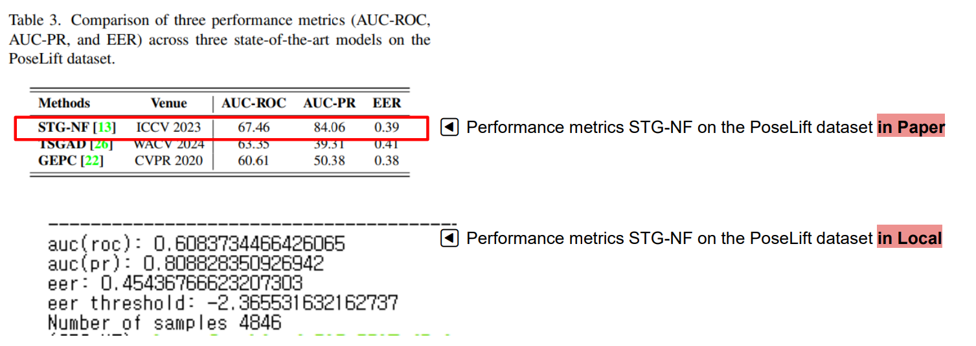
Project Development
Mecahism of STG-NF
24-Frame Sliding Window : After initial buffer, compute score every frame
Timing Analysis : Initial Buffering, Detection Latency, STG-NF Inference, YOLOv8 Pose
NLL (Negative Log-Likelihood) : quantifies how "surprising" a pose sequence is
Advantages of STG-NF
Lightweight :With very few parameters (~1K), it can run in real-time on any device capable of pose estimation.
Fairness : Focuses only on the 'action' itself, not on appearance, race, or gender, thus eliminating social bias.
SOTA Performance : Transform pose data using the ‘normal’ trained modelAchieved State-of-the-Art (SOTA) results
Let me explain the STG-NF Mechanism. STG-NF takes a sequence of 24 frames as input. There's an initial buffering period of approximately 0.8 seconds until the first 24 frames are accumulated.

Slide 15
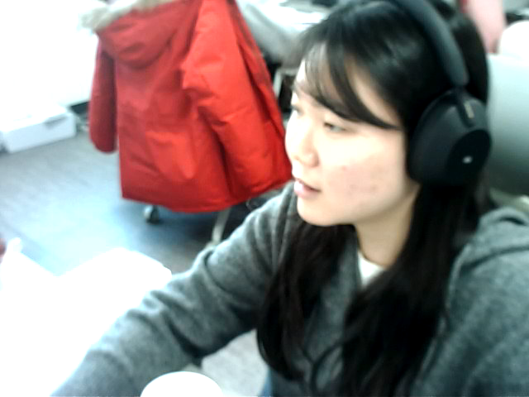
Project Development
Mecahism of STG-NF
24-Frame Sliding Window : After initial buffer, compute score every frame
Timing Analysis : Initial Buffering, Detection Latency, STG-NF Inference, YOLOv8 Pose
NLL (Negative Log-Likelihood) : quantifies how "surprising" a pose sequence is
Advantages of STG-NF
Lightweight :With very few parameters (~1K), it can run in real-time on any device capable of pose estimation.
Fairness : Focuses only on the 'action' itself, not on appearance, race, or gender, thus eliminating social bias.
SOTA Performance : Transform pose data using the ‘normal’ trained modelAchieved State-of-the-Art (SOTA) results
The important point is that after the buffer is filled, scores are computed for every subsequent frame. At frame 24, we use frames 1 through 24. At frame 25, we use frames 2 through 25. The window slides by one frame at a time.

Slide 16

Project Development
Mecahism of STG-NF
24-Frame Sliding Window : After initial buffer, compute score every frame
Timing Analysis : Initial Buffering, Detection Latency, STG-NF Inference, YOLOv8 Pose
NLL (Negative Log-Likelihood) : quantifies how "surprising" a pose sequence is
Advantages of STG-NF
Lightweight :With very few parameters (~1K), it can run in real-time on any device capable of pose estimation.
Fairness : Focuses only on the 'action' itself, not on appearance, race, or gender, thus eliminating social bias.
SOTA Performance : Transform pose data using the ‘normal’ trained modelAchieved State-of-the-Art (SOTA) results
After training, normal movements map near the center of the distribution, resulting in high likelihood or low NLL values. Abnormal movements map outside the distribution, resulting in low likelihood and high NLL values.

Slide 17
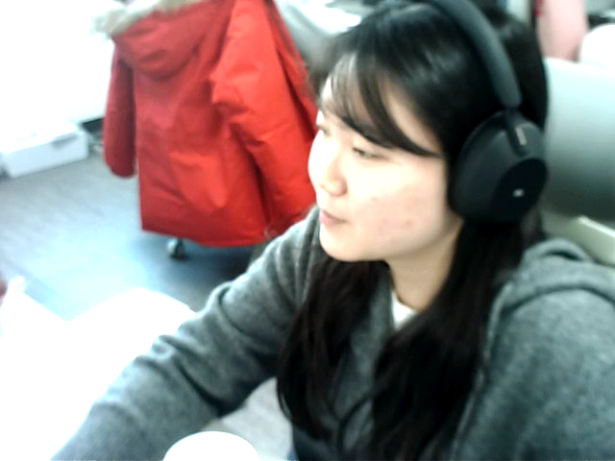
Project Development
Mecahism of STG-NF
24-Frame Sliding Window : After initial buffer, compute score every frame
Timing Analysis : Initial Buffering, Detection Latency, STG-NF Inference, YOLOv8 Pose
NLL (Negative Log-Likelihood) : quantifies how "surprising" a pose sequence is
Advantages of STG-NF
Lightweight :With very few parameters (~1K), it can run in real-time on any device capable of pose estimation.
Fairness : Focuses only on the 'action' itself, not on appearance, race, or gender, thus eliminating social bias.
SOTA Performance : Transform pose data using the ‘normal’ trained modelAchieved State-of-the-Art (SOTA) results
There are three main advantages to the STG-NF model we used.
First, it is extremely lightweight with only about 1,000 parameters, enabling real-time operation.

Slide 18

Project Development
Mecahism of STG-NF
24-Frame Sliding Window : After initial buffer, compute score every frame
Timing Analysis : Initial Buffering, Detection Latency, STG-NF Inference, YOLOv8 Pose
NLL (Negative Log-Likelihood) : quantifies how "surprising" a pose sequence is
Advantages of STG-NF
Lightweight :With very few parameters (~1K), it can run in real-time on any device capable of pose estimation.
Fairness : Focuses only on the 'action' itself, not on appearance, race, or gender, thus eliminating social bias.
SOTA Performance : Transform pose data using the ‘normal’ trained modelAchieved State-of-the-Art (SOTA) results
Second, it ensures fairness by focusing solely on the "pose" or action itself, eliminating bias related to appearance, race, or gender.

Slide 19
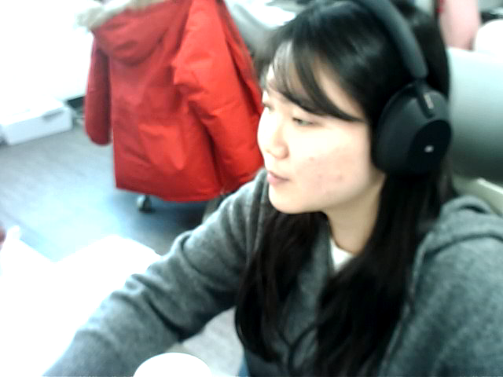
Project Development
Mecahism of STG-NF
24-Frame Sliding Window : After initial buffer, compute score every frame
Timing Analysis : Initial Buffering, Detection Latency, STG-NF Inference, YOLOv8 Pose
NLL (Negative Log-Likelihood) : quantifies how "surprising" a pose sequence is
Advantages of STG-NF
Lightweight :With very few parameters (~1K), it can run in real-time on any device capable of pose estimation.
Fairness : Focuses only on the 'action' itself, not on appearance, race, or gender, thus eliminating social bias.
SOTA Performance : Transform pose data using the ‘normal’ trained modelAchieved State-of-the-Art (SOTA) results
Third, it achieves State-of-the-Art (SOTA) performance on the PoseLift dataset compared to existing models.
We also confirmed significant performance metrics in our local environment tests.

Slide 20
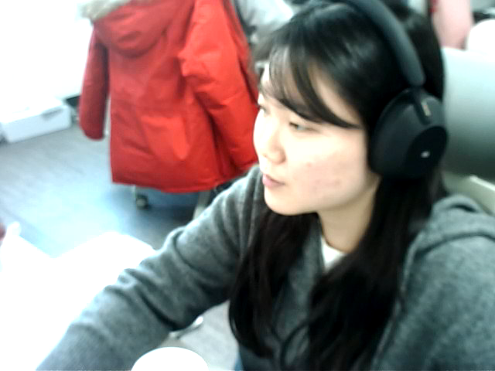
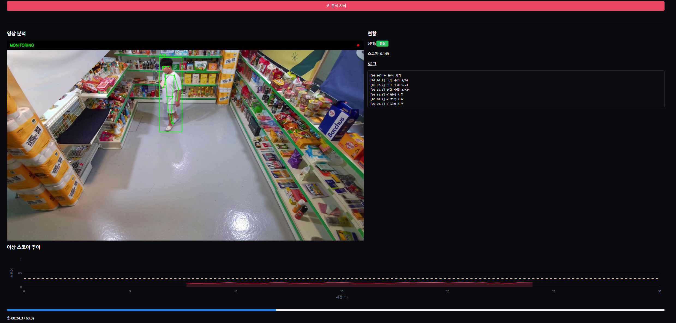
Interface
To demonstrate the system's practicality, we developed a web-based demo interface. What you see on the left is the interface layout. The main screen displays the video with real-time skeleton overlay, and the right panel shows the current status and anomaly score.

Slide 21

Interface
Key features include real-time skeleton visualization, live anomaly score tracking, buffering status indicator, and visual alerts upon anomaly detection. The tech stack uses Streamlit for the web UI, YOLOv8 for pose extraction, PyTorch for model inference, and OpenCV for video processing.

Slide 22

Q&A
This concludes my presentation. I would be happy to answer any questions you may have. Thank you.

